Slide 2
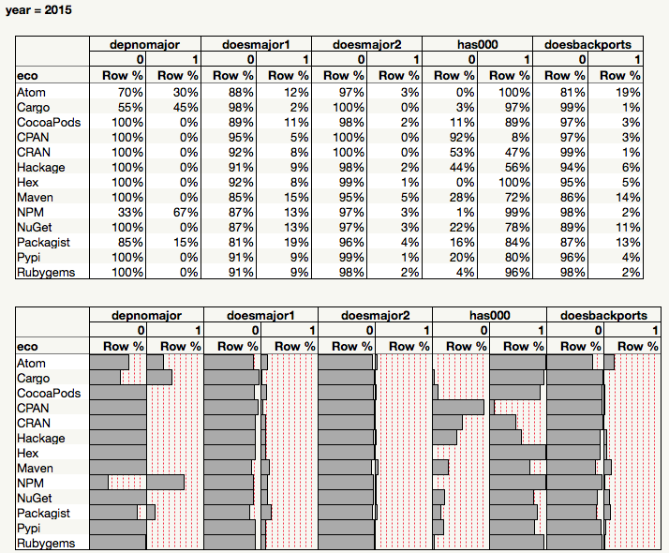

Slide 3
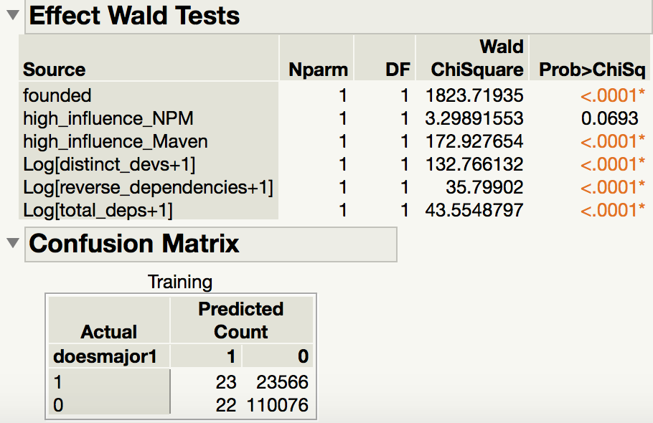
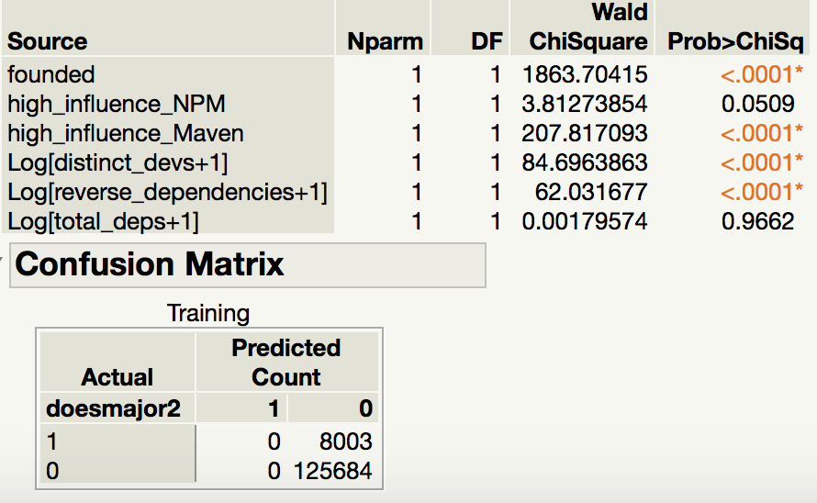
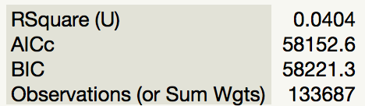
Maven 2015-2017: predicting major release
Maven 2015-2017: predicting 2 major releases

Slide 4
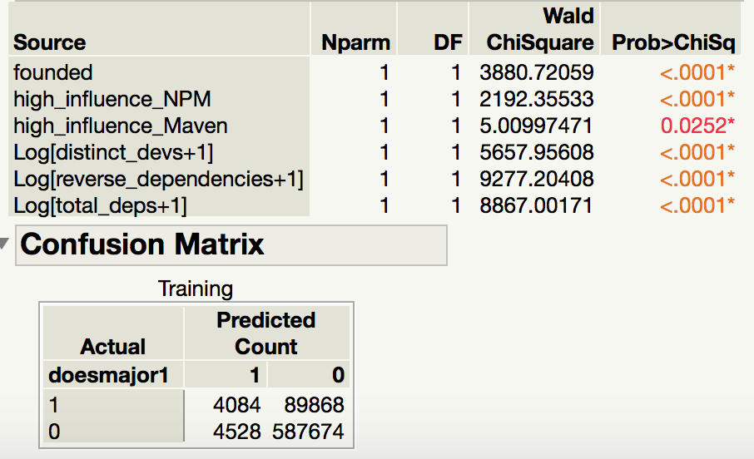
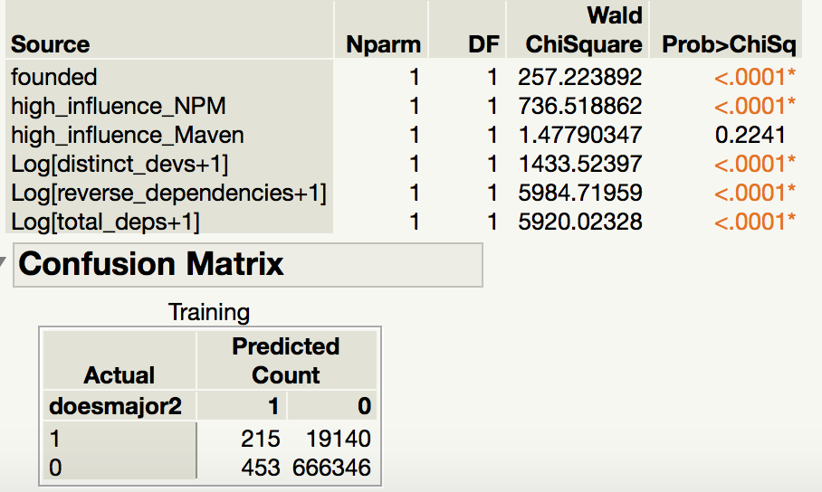
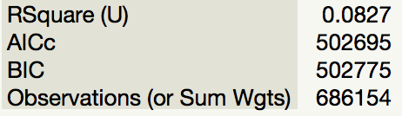
NPM 2015-2017 Two+ major release
NPM 2015-2017 Two+ major releases

Slide 5
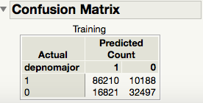
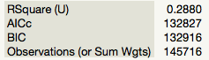
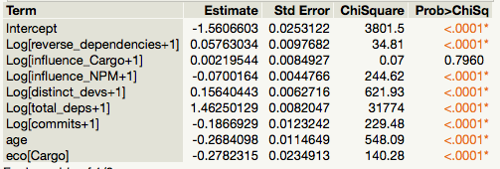
Model for Cargo and NPM, 2015
Predicting packages with 1+ dependencies allowed to float below next major version

Slide 6
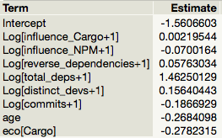
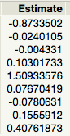
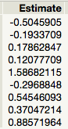
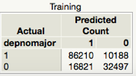
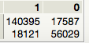
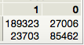
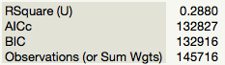
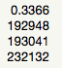
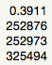
Cargo and NPM: Dependencies floating to non-major versions
Estimates for several years, compared
2015
2016
2017

Slide 8
Ratio of major releases to all releases

Slide 9
This is a normed histogram; the first bar
reaches 25 because bar width=.033; .033 x 25 = .833,
which is about what percent of packages have no
major releases.

Slide 11
Chi^2: major release ratio vs influence NPM and Maven
In 2012 NPM packages with high influence from Maven are **more** likely to have high level of major_ratio @ p= 7.853481276257805e-14
In 2012 Maven packages with high influence from NPM are **less** likely to have high level of major_ratio @ p= 0.8008065090319203
In 2016 NPM packages with high influence from Maven are **more** likely to have high level of major_ratio @ p= 1.530409794193904e-239
In 2016 Maven packages with high influence from NPM are **more** likely to have high level of major_ratio @ p= 0.001348984264692077

Slide 12
Chi^2: major release ratio vs influence Ruby and CRAN
In 2012 Rubygems packages with high influence from CRAN are **more** likely to have high level of major_ratio @ p= 7.738281221766641e-29
In 2012 CRAN packages with high influence from Rubygems are **more** likely to have high level of major_ratio @ p= 0.7614631371144539
In 2016 Rubygems packages with high influence from CRAN are **more** likely to have high level of major_ratio @ p= 2.828322589268213e-07
In 2016 CRAN packages with high influence from Rubygems are **less** likely to have high level of major_ratio @ p= 0.7517682024384902
tl;dr:
People who switch ecosystems release more major versions. *maybe* effect is more pronounced when going from low ecosystem to high

Slide 13
CPAN vs NPM
Ecosystem-wide major rel ratio
In 2015 CPAN packages with high influence from NPM are **more** likely to have high level of major_ratio @ p= 8.0191076390547e-08
In 2015 NPM packages with high influence from CPAN are **more** likely to have high level of major_ratio @ p= 4.085182398622528e-17

Slide 14
Mean practice level may be higher in the “low practice level” group

Slide 15
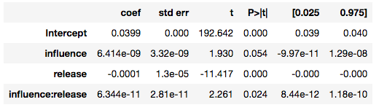
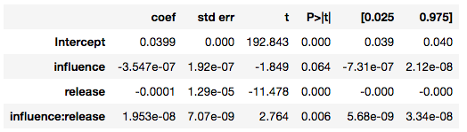
Other influences on major_ratio
NPM to NuGet
NPM to CRAN

Slide 16
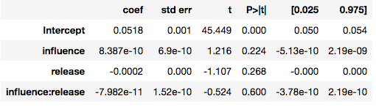
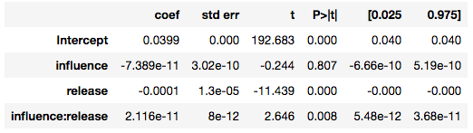
Regression major_ratio ~ influence * #releases
Maven influence on NPM
NPM influence on Maven

